Slide 1
WEEK 5

Slide 2
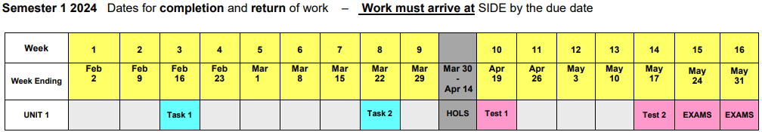
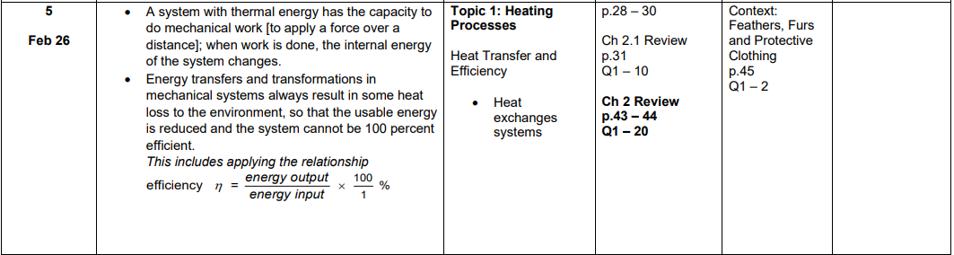

Slide 3
Recap Week 4
Different methods of heat transfer
Insulation
Evaporative air conditioners
Refrigerators and air conditioners

Slide 4
Learning Intentions
Describe how heat moves through systems (heat exchange) EG – Reverse cycle air-conditioning
Understand that nothing is ever 100% efficient and apply this to calculations involving efficiency
Perform simple calculations involving internal energy of systems

Slide 5
Heat Exchange or Conversion?
Heat exchange
Transfers heat from a warmer to a cooler location.
Eg countercurrent blood vessels
Heat conversion
Transforms the internal energy of the system
Eg engines, nozzles (pursed lips v open mouth air temp)

Slide 6
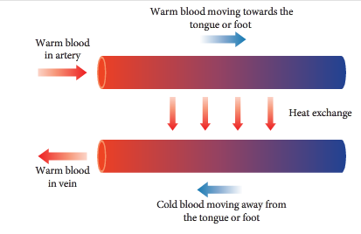
Countercurrent Heat Exchange
Skin, feet and tongues all over nature use it.
Arteries and veins are intertwined.
Warm blood swaps heat with cool blood.
Heat loss is minimised.
Emperor Penguins feet. Whale tongues. Human nostril capillaries

Slide 7
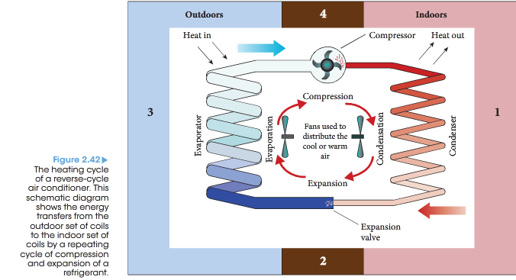
Reverse-Cycle Heating & Cooling

Slide 8
Heat conversion systems
Rapid gas expansion and compression
used in refrigeration and reverse cycle air conditioning to move energy from one region to another.
In Refrig. Air-con. The compressor forces particles closer together
Hot liquid in condenser coils transfer energy into the room (heater) or surroundings (air-con)

Slide 9
Cooler liquid refrigerant is passed through an expansion valve (nozzle)
Rapid adiabatic expansion
No total energy change here. Internal energy is re-balanced.
Potential energy increases, kinetic energy (temperature) decreases.
In the evaporator coils, evaporation is happening.
Latent heat required/absorbed. Comes from surroundings.
The coils are cold. Heat is also absorbed from warmer air passing over.

Slide 10
The cycle repeats
Refrigerant gas goes back into the compressor.
The compressor does the work. The compressor drives the cycle.
The cycle is reversible in some cases.
What swaps places and what stays?
Why does water often drip from air con units?
Google – How air conditioning works animation – you tube.

Slide 11
Getting useful Mechanical Energy
Steam power.
What do steam engines do?
Work. But how? and where does the energy come from?
Car engines. The four-stroke internal combustion engine.
Intake, compression, combustion, exhaust.
Combustion of energy-rich fuels = lots of heat and expanding gases.
Expanding gases can do work by driving pistons in a cylinder.
Notes:
Transform energy from chemical (from fuel) to heat in superheated steam then push a piston in a cylinder. Mechanical work is the result.

Slide 12
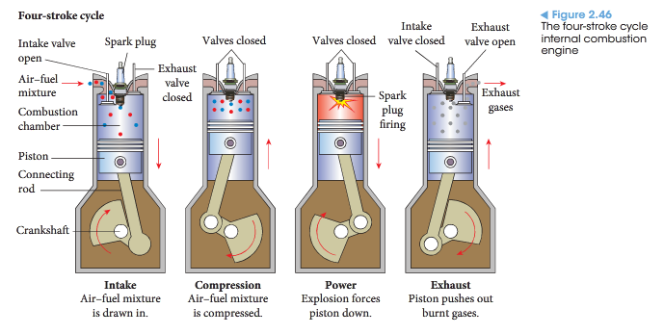
The 4-stroke Internal Combustion Engine

Slide 13
Nothing’s Perfect
Energy Efficiency = energy output / energy input
η (greek letter ‘eta’) is the symbol for efficiency.

Slide 14
Conservation of Energy in Open systems
Energy may never be created nor destroyed, but it may be transformed or transferred.
An open system is one where there may be some energy loss (or gain) to the surroundings.
In reality, all systems (except the universe) are open. Energy and matter may be transferred across system boundaries.
Many systems approximate closed systems

Slide 15
What does it mean?
For a car to be “fuel efficient”?
For a worker to be “working efficiently”
For a student to be
time efficient?
time inefficient?
Why is it important to consider the efficiency of our energy systems?

Slide 16
Energy Efficiency
Energy efficiency, η, is the fraction of the input energy that produces a useful output.
η = what you get out / what you put in
It is usually expressed as a percentage
A car is, at best, 30% efficient. Wow!

Slide 17
Question 1
A washing machine produced 12.4 kJ of useful mechanical energy from 18.6 kJ of electrical energy.
What is the efficiency of the washing machine?

Slide 18
Question 2
A car with an efficiency of 36% produced an amount of energy by combusting petrol with air. Of this energy, 230 kJ was converted to useful mechanical energy.
a) How much energy was produced by combustion?
b) How much energy was “wasted” and what form(s) did this energy take?

Slide 19
“Grade” of Energy
High Grade Energy Resources
Solar, Chemical, Electrical
These are very efficient, or useful, forms of energy.
Low Grade Energy Resources
Heat
Not efficient. Less useful.
When producing a desired output, all open systems transform energy from high-grade to low-grade energy.

Slide 20
Work
A system with thermal energy has the capacity to do mechanical work [apply a force over a distance].
When work is done, the internal energy of the system changes.
In mechanical systems (which are all open systems), all energy transfers and transformations always result in some heat loss to the environment.

Slide 21
Ins and outs
The change in internal energy of a system is equal to the energy added by heating (lost by cooling) plus the work done on the system (or minus the work done by the system)
ΔE_{int} = ΔQ + ΔW
Heat in +ve
Heat out -ve
Work done on the system. Work in +ve
Work done by the system. Work out -ve

Slide 22
Question 3
An open system has 370 kJ of heat added by combustion. The system does 250 kJ of work. 100 kJ of heat is lost to the surroundings.
What is the change in internal energy of the system?

Slide 23
REVISION HEAT
A nail is heated in an oven and then dropped into a large bucket of cold water. Which of the following statements about the situation is true?
A The nail and the water will both exchange heat until the total kinetic energy of each is the same.
B The nail has the highest energy content before it is transferred to the water.
C After equilibrium is reached, the heat energy content per gram of water and per gram of nail are different.
D The temperature change of the water will be greater than that of the nail.

Slide 24
REVISION HEAT
Which of the following is NOT due to the difference in rates of conduction of materials?
A A silver saucepan cools slower than a black one
B Ice melts more quickly when standing in a metal ice bucket than in a glass ice bucket
C A metal fence feels colder than a wooden one
D Dry socks keep the feet warmer than wet socks

Slide 25
REVISION HEAT
“Steam at 100ºC, burns the flesh more harmfully than an equal amount of water at 100ºC does”. True or false, and justify your answer.

Slide 26
REVISION HEAT
What mass of ice will melt when a 50 g lump of iron heated to 200 ºC is dropped into a large bucket of crushed ice at 0 ºC.
Specific heat capacity of iron = 459 J kg⁻¹ K⁻¹
Latent heat of ice as 3.35 x 10⁵ J kg⁻¹ K⁻¹
A. 14 g B. 16 g C. 18 g D. 20 g

Slide 27
REVISION HEAT
Tina knows that on a hot day the use of a ceiling fan helps to keep her cool. Before she goes out for several hours she decides to leave her fan on to cool the room. Is this good idea? Explain your reasoning.

Slide 28
REVISION HEAT
Why are gloves and thick-soled boots considered essential items for arctic exploration?
Why do arctic explorers always wear a thick woolen hat or balaclava on their head?

Slide 29
REVISION HEAT
What is the specific heat of an alloy if it requires 3.20 x 10⁴ J of energy to heat 1.20 kg of the alloy from 15.0 ⁰C to 92.5 ⁰C?

Slide 30
REVISION HEAT
A laboratory technician was trying to find the latent heat of fusion of an alloy she had created. She found that she needed to add 6.84 x 10⁵ J of energy to 1.95 kg of the alloy to fully melt it. Find the latent heat of fusion of the alloy.

Slide 31
REVISION HEAT
Amy carried out an experiment to determine the specific heat capacity of a substance X. She heated the 150 g block of X to 95.5 ºC, then put it into an insulated container which contained 425 g water with an initial temperature of 27.2 ºC. The final temperature reached after thermal equilibrium was 37.5 ºC.
a) Use this information to calculate the specific heat capacity of substance X.
For this calculation, what assumption did you have to make?

Slide 32
REVISION HEAT
An electric kettle is used to bring 0.500 kg of water initially at 25.0°C to boiling point.
It takes 2.50 minutes for the water to boil. Calculate the rate (in watts) that heat is being transferred to the water?

Slide 33
Success Criteria
Can you explain the process of reverse-cycle air-conditioning in terms of heat transfer processes?
Can you perform efficiency calculations?
Can you calculate the internal energy of substances using the work done on/by the substance and any heat gained/lost by the substance?

Slide 34


Student Feedback
What I learnt today…..
What I need to revise….
Images by clipart

